Slide 1

Steering maneuver recognition
ECE579
Fall 2023
Prof Yi Lu Murphy
Vehicle Battery SOC Estimation utilizing Machine Learning Models
Onkar Gunjkar
Harshit Barde
Axel Aguilar
Axel Aguilar, Harshit Barde & Sachin Lade

Slide 2
Motivation + Introduction (Project Overview)
The purpose of this project will be to estimate and optimize the %SOC value for a Vehicle Battery by using different machine learning models which will help us to provide a more accurate autonomy value for a given vehicle.
SOC estimation is necessary to get the information about remaining energy in high voltage batteries.
is very important in Electric and Hybrid Electric Vehicles to calculate and predict the range in miles or Kms.
Knowing this value correctly will help users and makers informed decision about vehicle’s energy usage and potential travel range.

Slide 3
State Of Charge (SOC)
Percentage of remaining usable energy of battery is known as %SOC
It is a very important factor in calculating the range of Electric Vehicle. Important Information like available energy in battery, making decision about journey routes could be made by using it.
Manufacturers can use this information to optimize battery management systems, improve overall vehicle performance and efficiency.
We can directly calculate the distance vehicle can travel by using %SOC. Hence, it has direct impact on autonomy value.
Accurate %SOC estimation opens doors for innovation in battery technology and energy management systems, further enhancing the electric vehicle industry.

Slide 4
Technologies Used in the Project
Python serves as the primary tool for tasks such as data loading, pre-processing, and the development of machine learning algorithms.
The collaborative aspect of coding is facilitated through Google Colab, providing a shared platform for seamless teamwork.
Machine learning algorithms and Neural Networks play a pivotal role in the project, as they are employed to both train and test models based on the three input parameters: Battery Voltage, Battery Current, and Battery Temperature.
For model validation and real-time processing, MATLAB and Simulink are utilized. These tools enable the validation of the developed model and the creation of insightful graphs through real-time processing, enhancing the overall understanding and accuracy of the project's outcomes.

Slide 5
Data Description
We are using the data set in which we are getting information about the battery temperature, voltage, and current. We have in Total 70 files from 2 different trips which has the data of BMW I3 vehicle Battery Parameters.
Link to Dataset: https://www.kaggle.com/datasets/atechnohazard/battery-and-heating-data-in-real-driving-cycles (Vehicle battery dataset)
For this project we are using 5 attributes Voltage, Current ,Temperature,Average Voltage, Average Current we have a single class which is the output of our system (State of Charge SOC).

Slide 6
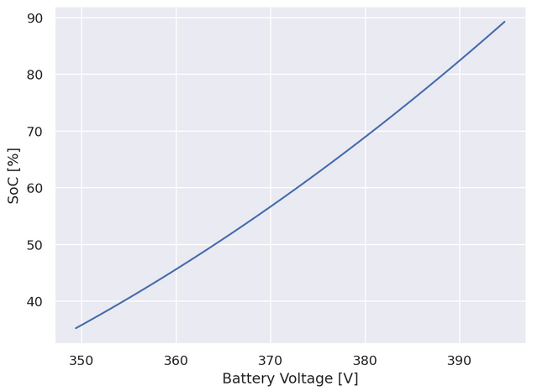
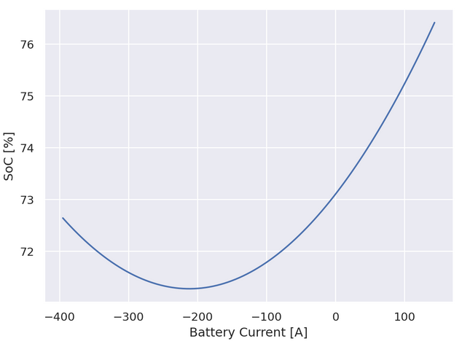
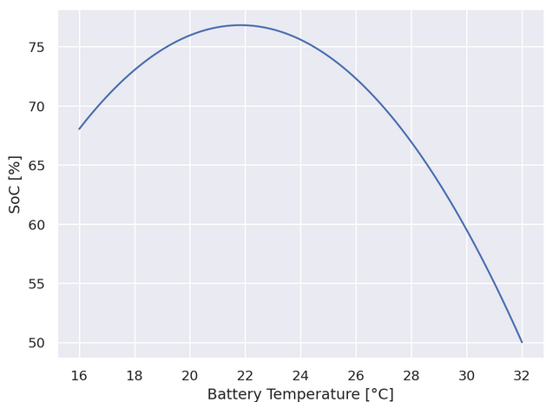
Exploratory Data Analysis
In this Phase of project we would be doing data visualization and analysis to find out important insights and relationship between dependent and independent variables in our dataset.
From the above graph we can clearly establish that State of Charge of the Battery is directly proportional to value of voltage, current and inversely proportional to value of battery voltage.

Slide 7
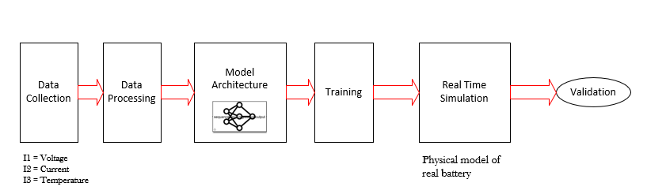
Methods used in the Project
Data Loading: Utilizing pandas, we load the data into a DataFrame for subsequent processing
Data Pre-processing: Performing data pre-processing involves handling null values and eliminating irrelevant features through thorough feature analysis.
Model Building: Employing algorithms such as linear regression, and neural networks, we construct various machine learning models.
Model Selection: Opting for the model with the lowest loss metric through rigorous evaluation
Real Time Simulation:Utilizing the selected model, we conduct a real-time simulation using MATLAB, validating and refining our results through simulated scenarios.

Slide 8
Neural Network Techniques
Layered Representation :
Neural network organization into multiple layers . Layers include an input layer, one or more hidden layers, and an output layer.
Training and Backpropagation:
Neural networks learn from data through training. Network shown examples with known correct answers during training. Compares predictions to correct answers, adjusts weights and biases to reduce error.
Non-Linear Feature Learning:
Deep neural networks capture intricate and non-linear relationships in data. Activation functions in each layer allow the network to discover complex patterns and features.
Feed Forward Neural Network:
A type of artificial neural network without looping nodes. Data flows from input nodes to hidden layers and finally to output nodes. No linkages in the network convey data back from the output node.

Slide 9
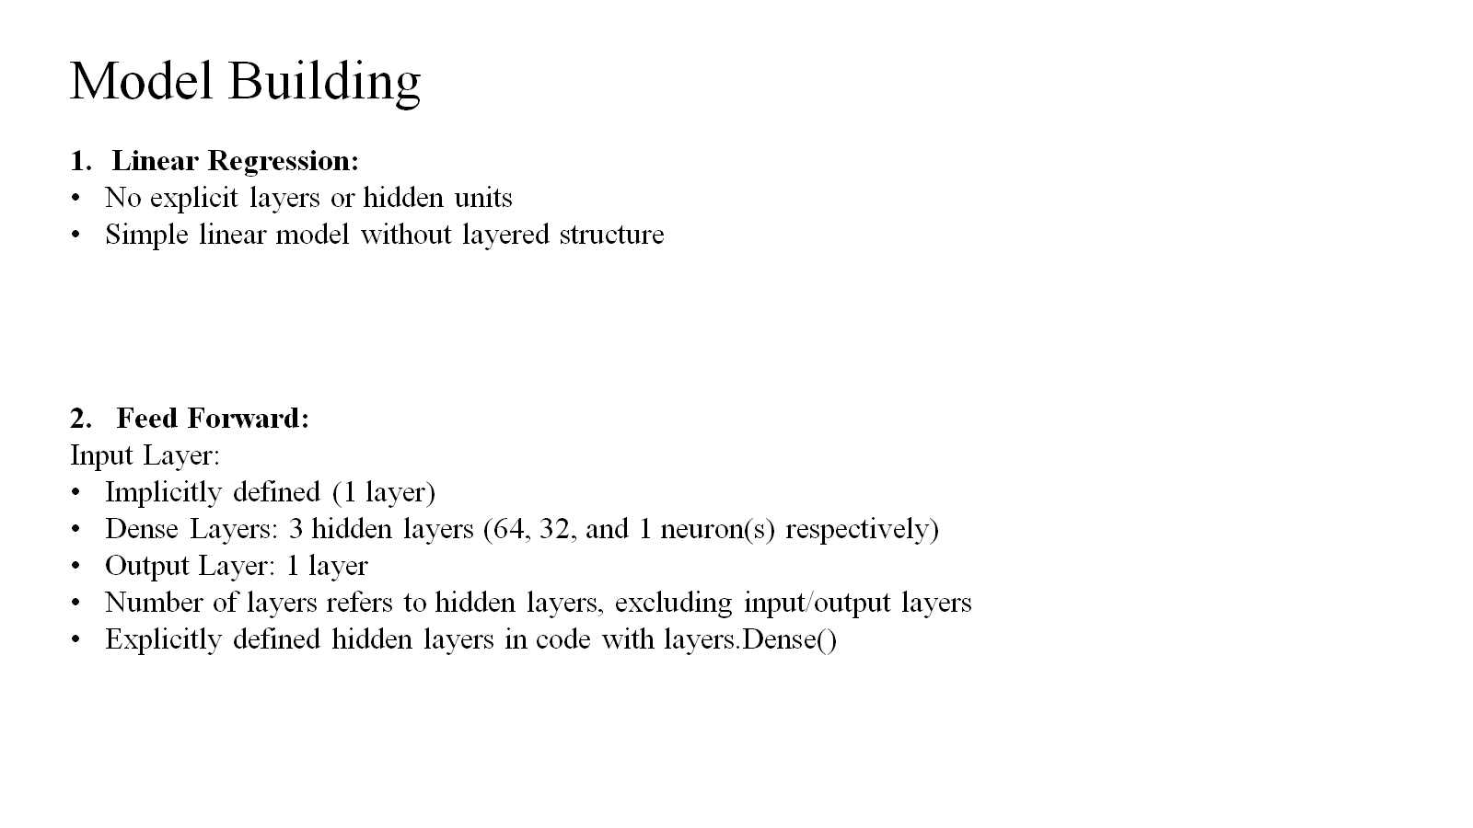

Slide 10
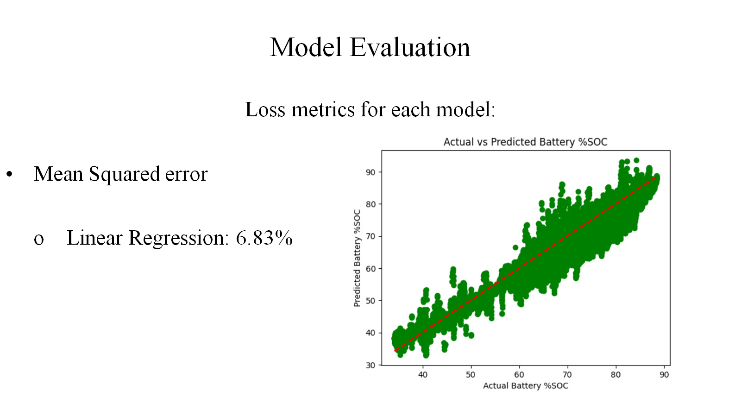
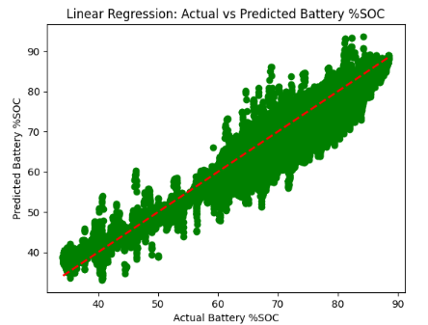
Model Evaluation
Loss metrics for each model:
Mean Squared error
Linear Regression: 7.31%
Decision Trees: 3.44%
Neural Networks: 3.16%

Slide 11
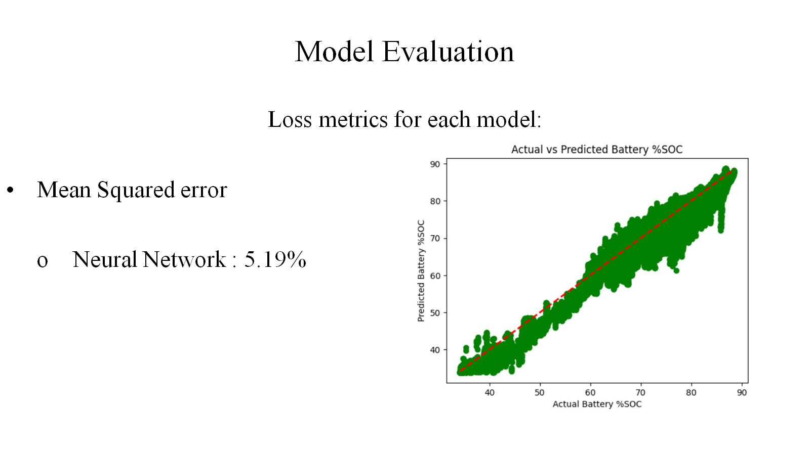

Slide 12
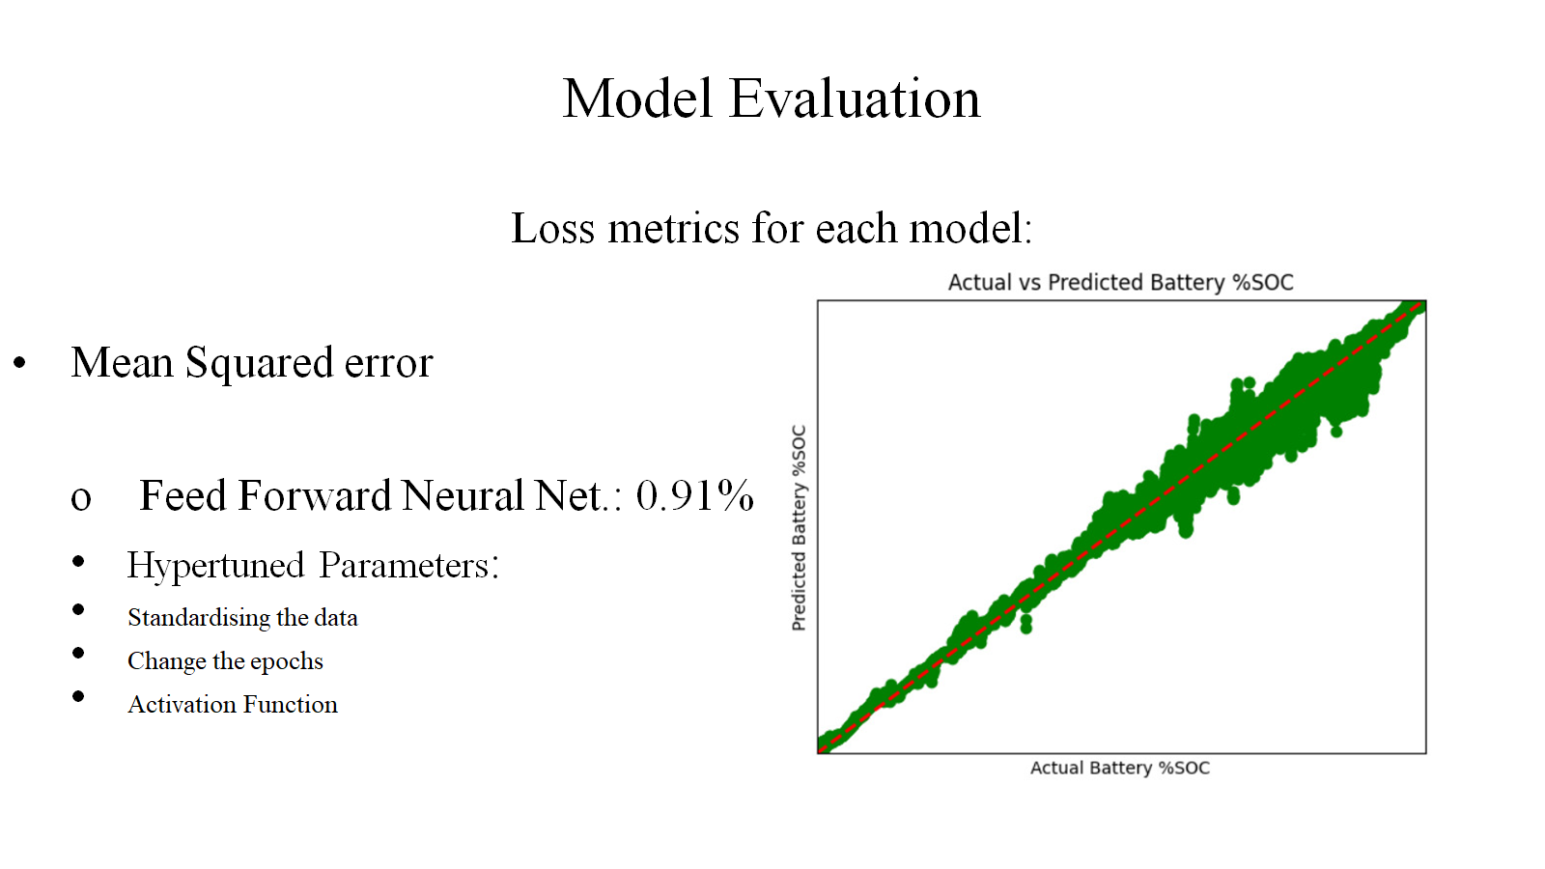

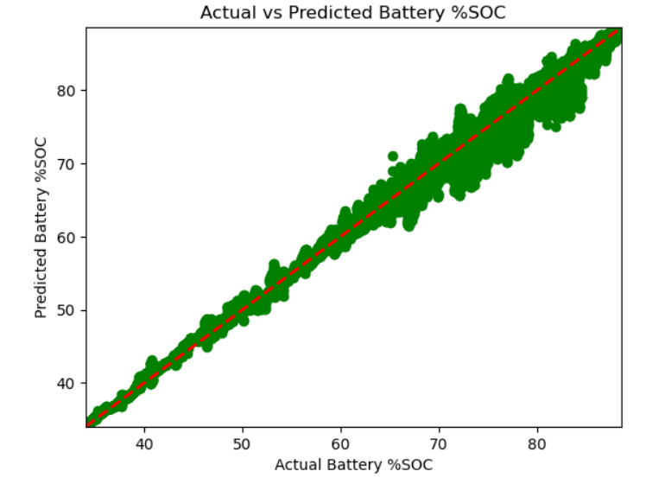

Slide 13
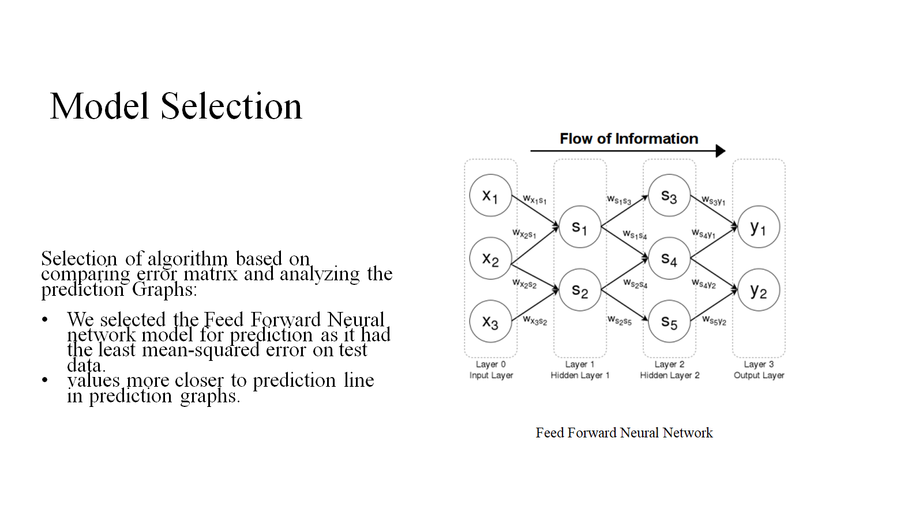

Slide 14

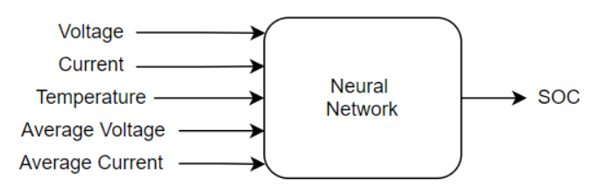
Neural Network in real time
Utilizing Tensor libraries, it is possible to export tensor Trained model to MATLAB in order to analyze and visualize data on Real-time application.
In order to better predict our SoC output value we need the voltage and current average values over time

Slide 15
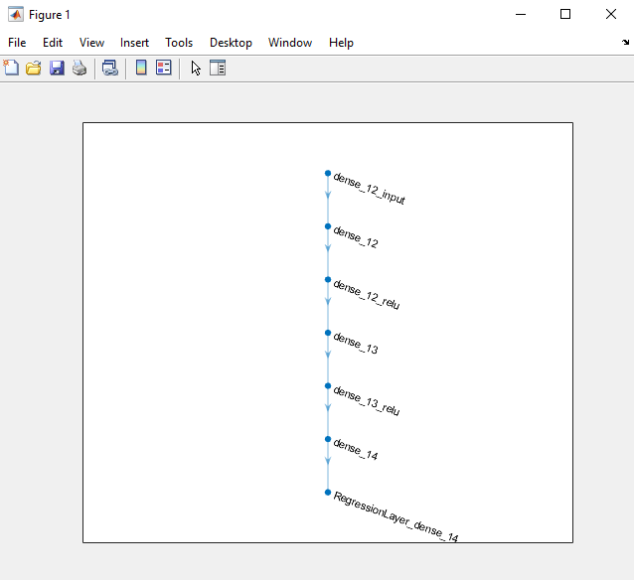
Neural Network analysis
Neural Network architecture has been imported to MATLAB successfully

Slide 16
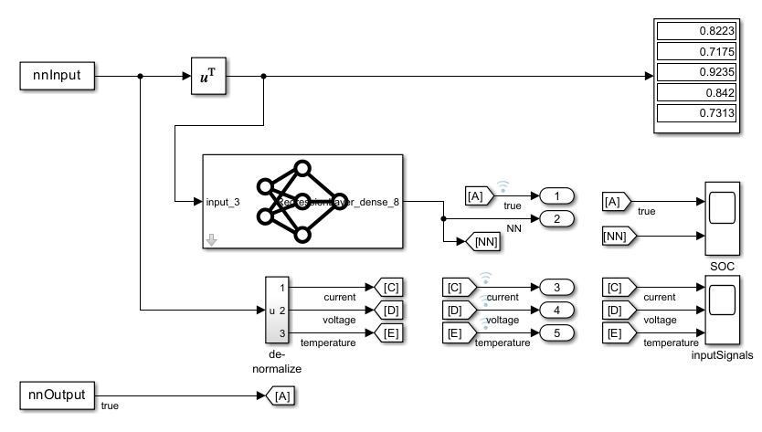
Neural Network in real time
SIMULINK simulation with Neural Network is giving predictions of SoC % values over time

Slide 17
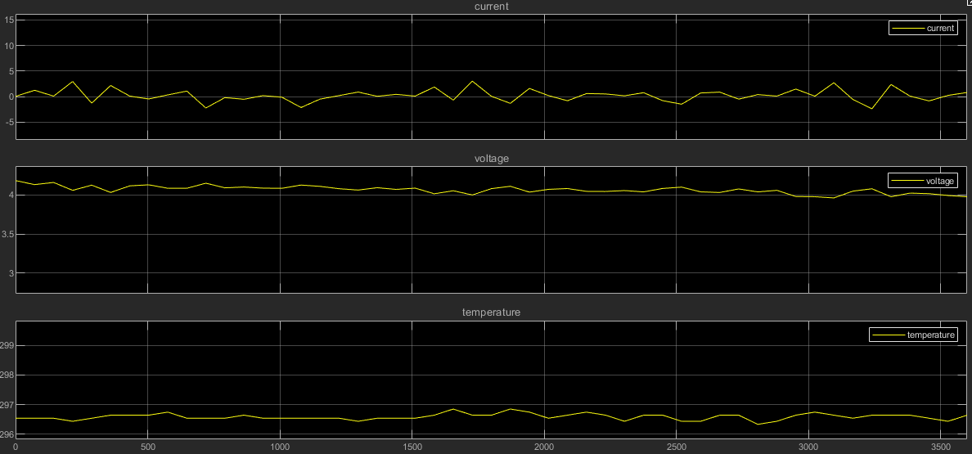
Neural Network in real time

Slide 18
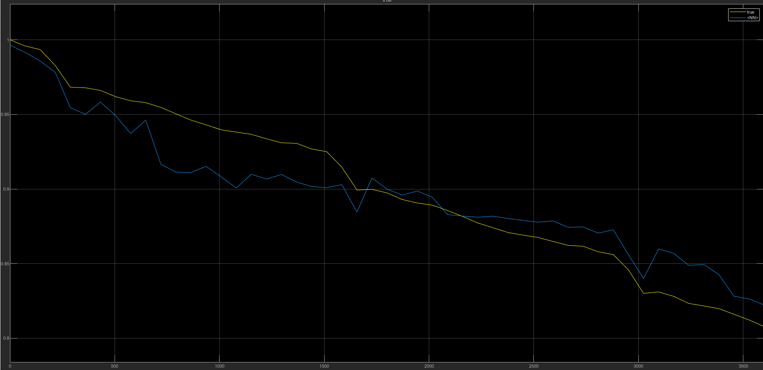
Experiments and Neural Network in real time

Slide 19
Conclusion
Our trained model using Feed Forward Neural Network is able to accurately predict the %SOC with least error.
Adding 4 & 5 parameter for average voltage and current values is important for real-time SoC estimation using neural network.
Real-Time Analysis can also predict %SOC accurately of our model in MATLAB.

Slide 20
Resources
[1] Suwarna Shete; Pranjal Jog; R. K. Kumawat; D.K. Palwalia “Battery Management System for SOC Estimation of Lithium-Ion Battery in Electric Vehicle: A Review”.2021 6th IEEE International Conference on Recent Advances and Innovations in Engineering (ICRAIE):01-03 December 2021
[2] Javier Sedano, Miguel Portal, Alejandro Hernández-Arauzo, José R. Villar, Jorge Puente, Ramiro Varela“INTELLIGENT SYSTEM FOR ELECTRIC VEHICLE CHARGING:DESIGN AND OPERATION”
[3]Mahmoud Ismail; Rioch Dlyma; Ahmed Elrakaybi; Ryan Ahmed; Saeid Habibi. “Battery state of charge estimation using an Artificial Neural Network”. 2017 IEEE Transportation Electrification Conference and Expo (ITEC), 22-24 June 2017.
[4] S. Qingsheng, Z. Chenghui, C. Naxin, and Z. Xiaoping, "Battery state-of-charge estimation in the electric vehicle using Elman neural network method", Control Conference (CCC) 2010 29th Chinese, pp. 5999-6003, 2010.
[5] Z. Chen, S. Qiu, M. A. Masrur and Y. L. Murphey, "Battery state of charge estimation based on a combined model of extended Kalman filter and neural networks", Neural Networks (IJCNN) The 2011 International Joint Conference, pp. 2156-2163, 2011.
[6] Vidal, C., Kollmeyer, P., Naguib, M., Malysz, P., et al., "Robust xEV Battery State-of-Charge Estimator Design Using a Feedforward Deep Neural Network," SAE Int. J. Adv. & Curr. Prac. in Mobility 2(5):2872-2880, 2020, https://doi.org/10.4271/2020-01-1181.
Tensor Flow to MATLAB:
https://blog.tensorflow.org/2023/03/tensorflow-with-matlab.html

Slide 21


